Slide 1





Presentation
CARTIFY
BRIEF
Multi-Vendor E-Commerce Platform
Enterprise-grade solution for merchants and customers
Tech Stack: ASP.NET Core Web API, HTML/CSS/JS Frontend, SQL Server, AWS

Slide 2
Agenda
2025
/2
AGENDA
/10
CARTIFY OVERVIEW & OBJECTIVES
/12
SYSTEM ARCHITECTURE (BACKEND & FRONTEND)
/16
CORE FEATURES (MERCHANT & CUSTOMER MODULES)
/19
DATABASE, SECURITY, AND DEPLOYMENT

Slide 3

2025
TEAM MEMBERS
/1
/2
/3
AHMED IBRAHIM
TAQEY ELDEEN
AMR KHALED
/4
/5
/6
MOSTAFA NASR
MARK OSAMA
MOHAMED RAOUF

Slide 4
2025
AHMED IBRAHIM - TEAM LEADER
/1
/2
Implemented all core backend endpoints: Product, ProductDetails, Attributes, Measure Units, Category, SubCategory, Inventory, Orders, Customers.
Designed the entire database schema and all entity relationships (Product → ProductDetails → Inventory).
/3
/4
/5
Contributed to and enforced Clean Architecture standards across layers.
Integrated AWS S3 for image storage using Signed URLs; supported deployment on EC2 / RunASP, RDS, and VPC (public/private subnets).
Team Leadership & Integration Reviewed code, fixed bugs, and supported teammates during development.

Slide 5
2025
TAQEY ELDEEN
/1
/2
structure Clean Architecture, Repository Pattern, and Unit of Work.
Implemented JWT + Refresh Token authentication.
/3
/4
/5
Added Role-Based Authorization (Customer, Merchant, Admin).
Built authentication endpoints: Login, Register, Forget Password, Refresh Token.
Added Help Controller to allow users to submit support tickets.

Slide 6
2025
AMR KHALED
/1
/2
Built Category, SubCategory, Product, and Product Details pages.
Implemented dynamic relations between catalog components.

Slide 7
2025
MARK OSAMA ATIA
/1
/2
Implemented the complete Checkout Flow and order confirmation.
Built Customer Profile pages and account management UI.
/3
/4
Developed Order Tracking with status updates.
Ensured full responsive design across devices.

Slide 8
2025
MOHAMED RAOUF
/1
/2
Implemented the Admin Controller and administrative endpoints.
Developed backend services handling admin business logic.
/3
Created and maintained Admin DTOs for clean data transfer and API consistency.

Slide 9
2025
MOSTAFA NASR
/1
/2
Implemented the Wishlist and Cart Controllers.
Built order tracking, help, cart, and wishlist pages

Slide 10


Cartify
2025
ABOUT CARTIFY
Overview of Cartify as a scalable, modular e-commerce system supporting multiple merchants, stores, and customers with secure operations.

Slide 11
Cartify
2025
A BUSINESS PROBLEM
Traditional e-commerce systems lack multi-vendor support, centralized management, performance optimization, and cloud scalability.
Cartify solves these gaps using clean architecture and a cloud-backed design.

Slide 12
Cartify
2025
A SYSTEM GOALS
Provide a unified marketplace for multiple merchants
High performance and secure backend API
Simple, responsive merchant dashboard
Scalable cloud-ready architecture

Slide 13
Cartify
2025
DATABASE DESIGN
Erd
The database is designed with a fully normalized structure to ensure data integrity, scalability, and clear separation of responsibilities between entities.
Product Structure
Product represents the main product concept (e.g., Realme 8).
ProductDetails stores different variants of the same product (RAM, storage, processor).
Inventory manages stock information for each product variant, including quantity and availability.
This design avoids data duplication and allows precise control over product variants and stock.
Order Structure
Merchant owns one or more Stores.
Store receives Orders from customers.
OrderDetails contains the products, quantities, and prices for each order.
Separating orders from order details ensures accurate order history even if product prices change later.
Data Integrity & Normalization
All relationships are enforced using foreign keys.
The schema follows 3rd Normal Form (3NF) to eliminate redundancy.
The design supports future extensions without impacting existing data.

Slide 14
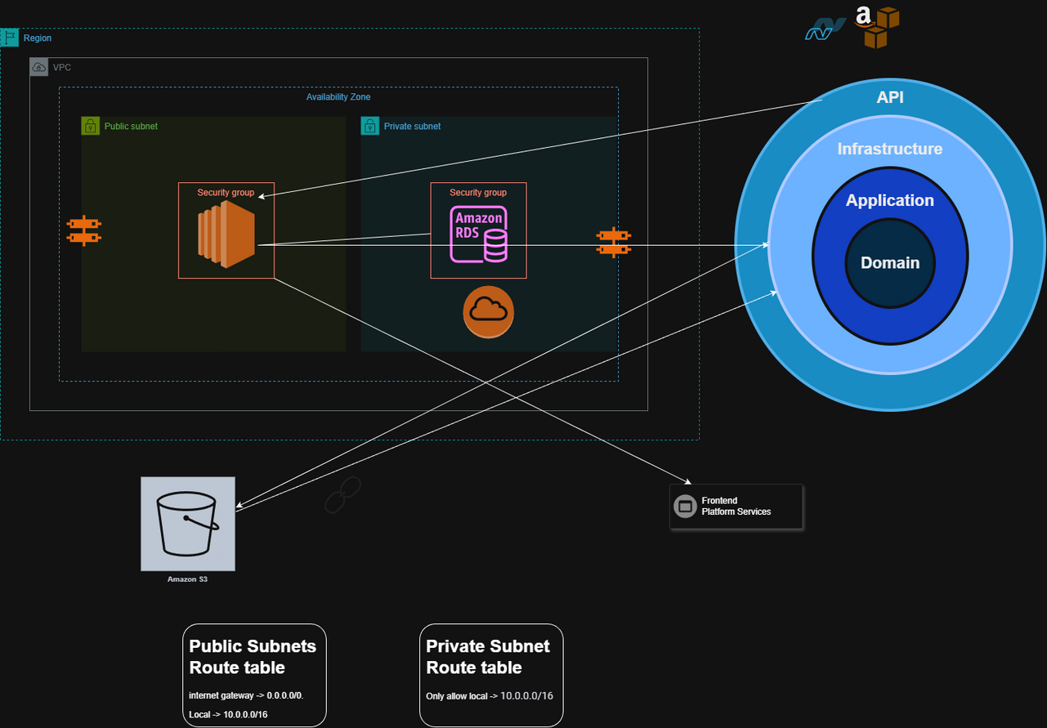
Cartify
2025
CLOUD ARCHITECTURE & CLEAN ARCHITECTURE INTEGRATION (AWS + .NET)

Slide 15
Cartify
2025
HIGH-LEVEL ARCHITECTURE
Cartify follows Clean Architecture:
Domain → Application → Infrastructure → API
Ensures separation of concerns, testability, maintainability, and scalability.

Slide 16
Cartify
2025
DOMAIN LAYER
Contains enterprise logic:
Entities: Product, ProductDetails, Inventory, Merchant, Customer, Order
Value Objects, Rules, Interfaces
No dependency on external layers.

Slide 17
Cartify
2025
APPLICATION LAYER
Contains business rules and use cases:
Product Management, Order Management, Merchant Services
Uses DTOs, Validators.
Depends only on Domain.

Slide 18
Cartify
2025
INFRASTRUCTURE LAYER
Implements external concerns:
SQL Server database
Entity Framework Core
Repositories
AWS S3 Storage Services
Authentication and authorization providers

Slide 19
Cartify
2025
INFRASTRUCTURE LAYER
Implements external concerns:
SQL Server database
Entity Framework Core
Repositories
AWS S3 Storage Services
Authentication and authorization providers

Slide 20
Cartify
2025
API LAYER
ASP.NET Core Web API
Controllers for merchants and customers
Request validation, response models, JWT authentication, exception handling
Swagger/OpenAPI documentation

Slide 21
Cartify
2025
MERCHANT MODULE OVERVIEW
Dedicated backend endpoints for merchant operations:
Products, inventory, orders, revenue, analytics
Merchant dashboard built using HTML/CSS/JS + Fetch API.

Slide 22
Cartify
2025
ADMIN MODULE OVERVIEW
Admin Responsibilities
Manage merchants, customers, categories, and system configurations.
Oversee product lifecycle across all vendors.
Monitor platform performance and handle moderation tasks.
Features Implemented
Full Admin Controller handling all administrative actions.
Backend services for data validation, business rules, and repository interaction.
Well-structured DTOs for clean request/response models.
Secure access through role-based authorization.

Slide 23
Cartify
2025
PRODUCT MANAGEMENT
Merchants can:
Create products
Add product details with attributes and measure units
Manage inventory with serial numbers
Upload images using S3 and receive URLs stored in DB

Slide 24
Cartify
2025
ORDER MANAGEMENT
Merchants can:
View orders
Filter by order status
Update order status (processing, shipped, delivered)
View order summary and transactions

Slide 25
Cartify
2025
CUSTOMER EXPERIENCE
Customers can:
Browse products
View product details
Add to cart and checkout
Track orders
Secure authentication

Slide 26
Cartify
2025
BACKEND FEATURES OVERVIEW
Clean architecture implementation
SQL Server with relational modeling
Authentication with JWT
Inventory and product detail logic
Exception middleware
File upload using S3
Full RESTful endpoints with pagination and filtering

Slide 27
Cartify
2025
FRONTEND OVERVIEW
Merchant Dashboard includes:
Product page
Product details editor
Inventory view
Orders dashboard
Revenue analytics
Built with modular JavaScript, clean UI, Fetch API integration.

Slide 28
Cartify
2025
S3 INTEGRATION
Images uploaded directly to AWS S3
Returned signed URL stored in SQL Server
Used by frontend for product display
Improves scaling and avoids server storage issues.

Slide 29
Cartify
2025
SECURITY
JWT-based authentication
Role-based authorization
Secure API key usage
Input validation
CORS configuration for production frontend URL

Slide 30
Cartify
2025
DEPLOYMENT
Backend deployed on runasp.net
Frontend deployed on Netlify / static hosting
Supports cloud migration to EC2, RDS, and S3

Slide 31
Cartify
2025
CONCLUSION
Cartify is a production-ready, scalable e-commerce platform built with a strong architecture, powerful backend, clean frontend, and cloud integration.
Supports real merchants and customers, ready for expansion.

Slide 32
Goals
2025
GOALS
Cartify
Build a scalable multi-vendor e-commerce platform supporting merchants, stores, and customers.
Implement clean, modular architecture to ensure maintainability, testability, and long-term growth.
Goal 01
Goal 01
Enable easy integration and deployment using RESTful APIs, SQL Server, and AWS services (S3, hosting).
Deliver a secure and responsive system with JWT authentication, validated inputs, and cloud-backed storage.
Goal 03
Goal 04

Slide 33



Presentation
THANK YOU
Website
THIS IS CARTIFY.COM

